Slide 1
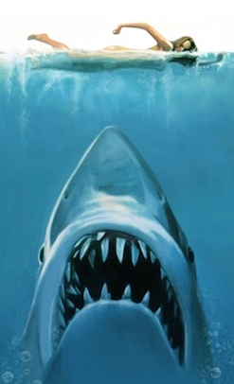
Shark Attacks

Slide 2

If you go to the beach in WA, are you less likely to be attacked by a shark than be a pedestrian involved in a car accident?
According to statistics, Australia ranks second in the world for the number of shark attacks, right behind USA in 2018 (Source: https://www.finder.com.au). This is also followed by regular reporting of shark attacks all over the news which cast fear amongst the population on danger of holidaying near the coasts.
Given the above, this project has been conducted to assess the likelihood of being attacked by sharks and convince them that swimming at the beach is not as dangerous as it seems.

Slide 3

Methodology
Question: If you go to the beach in WA, are you less likely to be attacked by a shark than be a pedestrian involved in a car accident?
Variables considered in this project:
Number of shark attacks between 2016-2020
Number of shark sightings between 2016-2020
Shark attacks by region
Frequency of shark attacks according to time of the day
Human activities undertaken during shark attack
Number of news reports in comparison to number of shark attacks
Comparison against car accidents involving pedestrians

Slide 4





Methodology – cont.
Steps Taken:
Step 1 – Determine the output required
Step 2 – Determine what data is available to obtain the desired output
Step 3 – Determine the work and tools required (i.e data cleaning, coding, etc.)
Step 4 – Allocate the work amongst team members
Tools Involved:
Python (API, Gmap, Pandas)
Microsoft Excel
ParseHub
Git Hub
Google Drive
Notes:
Note: maybe we can show them the work allocation spreadsheet?

Slide 5
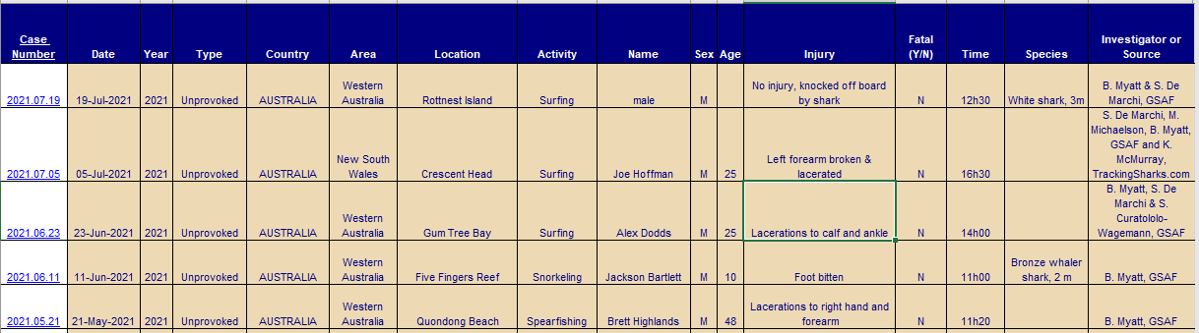
Data 1 –Shark Attacks Across Australia
Steps Taken:
An excel spreadsheet was obtained from Global Shark Attack File (https://www.sharkattackfile.net/incidentlog.htm), and data cleaning was undertaken (i.e filtered for Australian attack across 2016-2020).
Using Python, the Group has also categorised attacks across Western Australia area into 3 groups, being Northern, Metro, and Southern region in a separate dataframe.
Gmaps was also utilised to obtain estimate latitude & longitude of location of attack based on Location column.
Additional columns were added manually in the spreadsheet to group time of attack into Dawn, Daytime, Dusk, Nighttime.
Using Python, further cleaning was done on Activity Column to create major activity group that was being undertaken during the shark attack (i.e Surfing Varieties, Swimming, Fishing, Snorkeling, Wading, and Misc.).
Once the above data cleaning process was completed, Python codes were run to create bar graphs and heatmaps where relevant.
Notes:
Note to Presenter
Please talk about how we have spent at least half of the time with data searching & data cleaning prior to commencing coding process.
For point 1 to 3, Katherine can present her code
For point 4 and 5, Cathy can present her code
Time Grouping: Dawn (4am to 8am), Daytime (8am to 4pm) Dusk (4pm to 8pm), Nightime (8pm to 4am)
Region Grouping: Perth & Peel to be considered as metropolitan area; Anything above Yanchep is classified as Northern WA; Anything below Dawsville is Southern WA

Slide 6
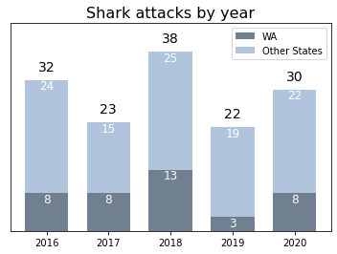
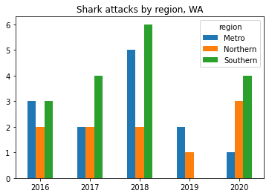
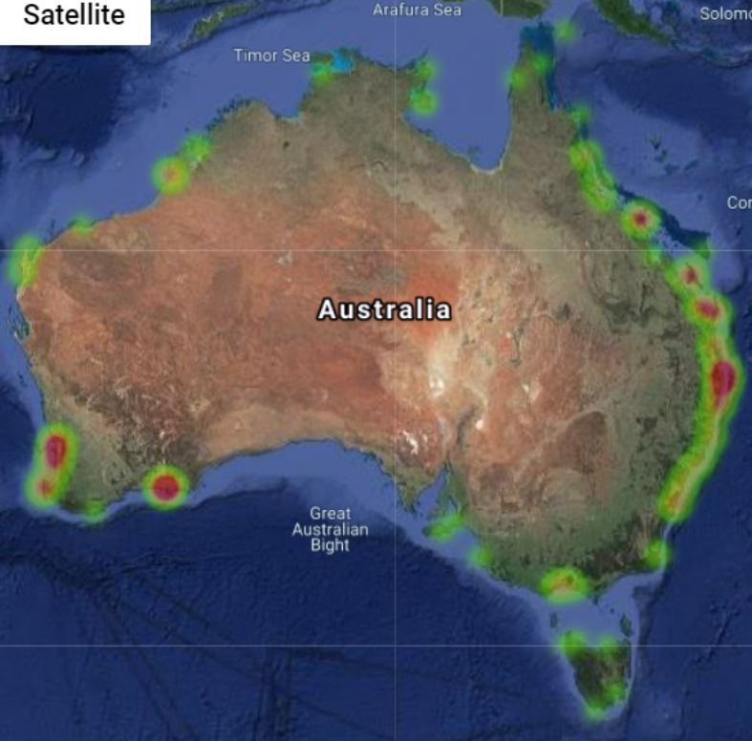
Data 1 Results – Shark Attacks Across Australia
Shark attacks by location
Observation:
Number of shark attacks in the last 5 years across Australia averaged to 29 attacks per year, with WA state averaging to 8 per year
In the last 5 years, most shark attacks in WA happens in the Southern Region, then followed by Metro region.
Notes:
Katherine to Present
Katherine -> can you please edit the region graph bar with a title? Feel free to change the coloring as well.

Slide 7
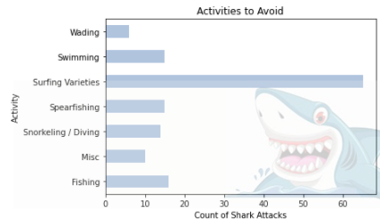
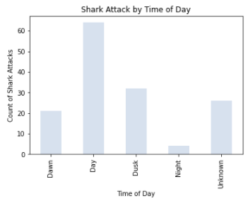
Data 1 Results – Shark Attacks based on Activities & Time of Day across Australia (2016-2020)
Observation:
Majority of shark attacks occur during the daytime (between 8am to 4pm) and dusk (between 4pm to 8pm).
Most shark attacks occurs while the victims were surfing with total number of 70 cases. The remaining activities such as swimming, fishing, and spearfishing shows a considerably lower number of cases of less than 20 for each.
Notes:
Cathy to present
Time Grouping: Dawn (4am to 8am), Daytime (8am to 4pm) Dusk (4pm to 8pm), Nightime (8pm to 4am) and Unknown (no information provided)
Shark attack by day figures: Dawn 22, Day 73, Dusk 38, Night 4, Unknown 26
Shark attack by activities figures: Surfing Varieties 70, Swimming 19, Fishing 17, Spearfishing 17, Snorkeling / Diving 16, Misc 11, Wading 6

Slide 8
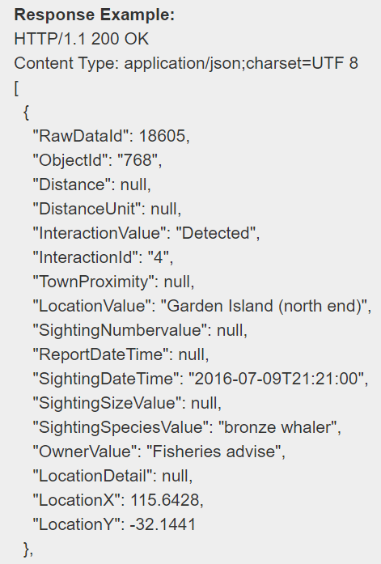
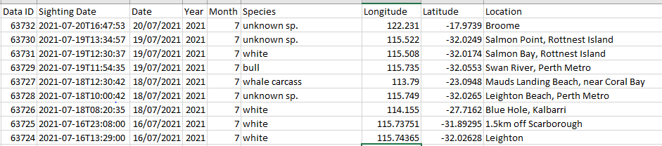
Data 2 –Shark Sightings Across Western Australia
Steps Taken:
Python API code was run through http://api.fish.wa.gov.au/webapi/v1/RawData to extract all reported shark sightings in WA. Information extracted include sighting date and location (location name, latitude, longitude).
A DataFrame was then created using Panda and converted into a csv file. Some minor data cleaning was undertaken in the csv file to separate date and year of sightings in the Sighting Date Column.
Charts and heatmaps were created to reflect the data acquired.
Notes:
Note to Presenter
Please talk about how we have spent at least half of the time with data searching & data cleaning prior to commencing coding process.
For point 1 to 3, Katherine can present her code
For point 4 and 5, Cathy can present her code
Time Grouping: Dawn (4am to 8am), Daytime (8am to 4pm) Dusk (4pm to 8pm), Nightime (8pm to 4am)
Region Grouping: Perth & Peel to be considered as metropolitan area; Anything above Yanchep is classified as Northern WA; Anything below Dawsville is Southern WA

Slide 9
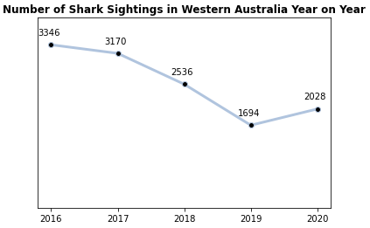
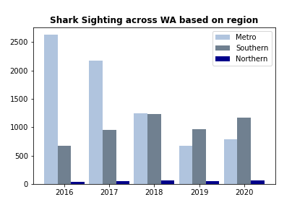
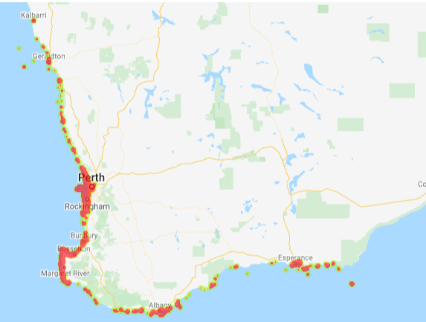
Data 2 Results – Shark Sightings Across Western Australia
Shark sightings by location
Observation:
There has been a declining trend in the number of shark sighting across WA in the last 5 years, with exception for 2020 whereby the number of sightings has increased slightly
Highest number of shark sightings were noted in Metro area, but this continues to decline when Southern region starts recording more sightings in 2019-2020
Heatmap above notes the total number of sightings between 2016-2020 noting large number of sightings occurs in Metro and Southern region
Notes:
Katherine to Present
Katherine -> can you please edit the region graph bar with a title? Feel free to change the coloring as well.

Slide 10
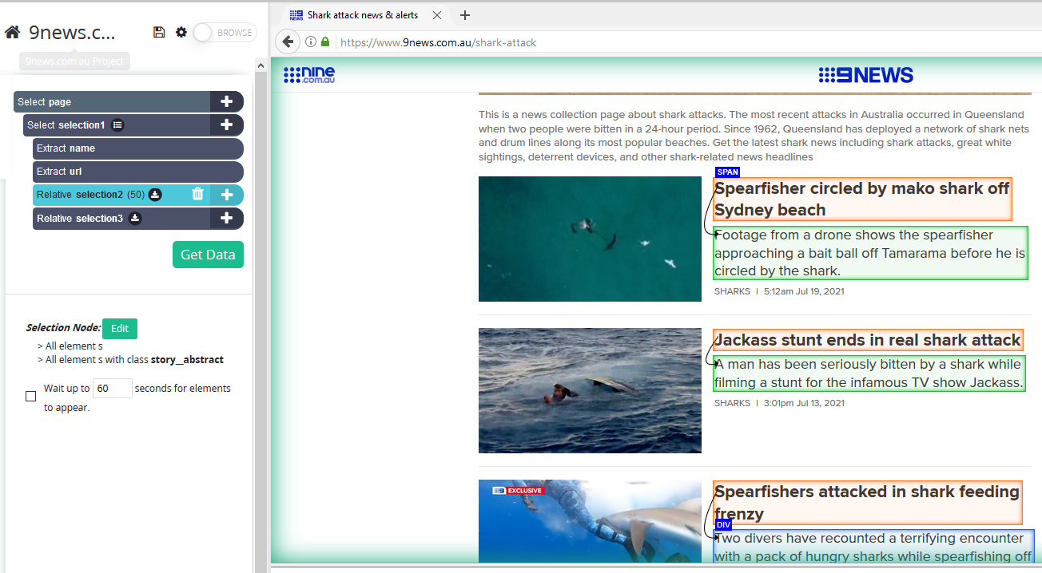
Data 3 – Shark news reporting in Australia
Steps Taken:
Shark articles have been obtained from 9news and extracted using ParseHub into an excel spreadsheet.
Once an excel file has been generated, manual processing was involved to clean the data which includes checking the relevancy of the article to shark attacks in Australia, checking whether the article covers victim’s activities prior to shark attack.
It is also worth noting that the data only covers a period from mid 2017 to mid 2021, and as such, analysis has only been carried out for period 2018-2020
The data was summarised using Python as follows:
No. of shark related articles vs no. of shark attack articles
Comparison of actual shark attacks in Australia (covered in Data 1) vs no. of shark attack articles published
Activities carried out prior to shark attack outlined in the articles
Source:
https://www.9news.com.au/shark-attack
https://www.parsehub.com/
https://www.youtube.com/watch?v=noqkJciAfWE
Notes:
Relevance is judged from (i.e is the article a referring to the same topic covered previously?; is the article related to shark attacks by itself or is it talking about politics and research involving sharks?; is the article covering news in Australia?)

Slide 11
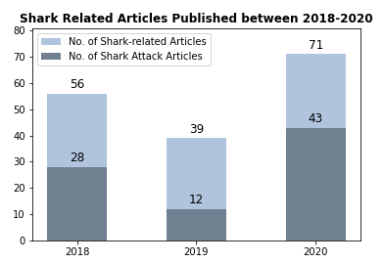
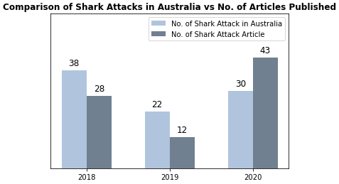
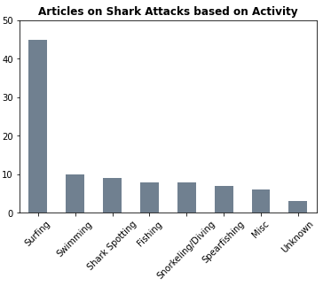
Data 3 Results – Shark news reporting in Australia
Observation:
Throughout 2018-2019, the number of non-shark attack articles were more than double the number of shark attack articles, with exception of 2020
In 2018-2019, more than 50% of shark attacks were reported in 9news, however, in 2020, the number of shark attack articles published exceeds the number of actual shark attacks. This is because some articles published repeats on the same attacks that were reported in the previous days (in 2020, there are 43 articles identified that falls under this category)
Number of shark attacks while victims are surfing continue to be the highest, in line with Data 1 results
Notes:
Katherine to Present
Katherine -> can you please edit the region graph bar with a title? Feel free to change the coloring as well.

Slide 12
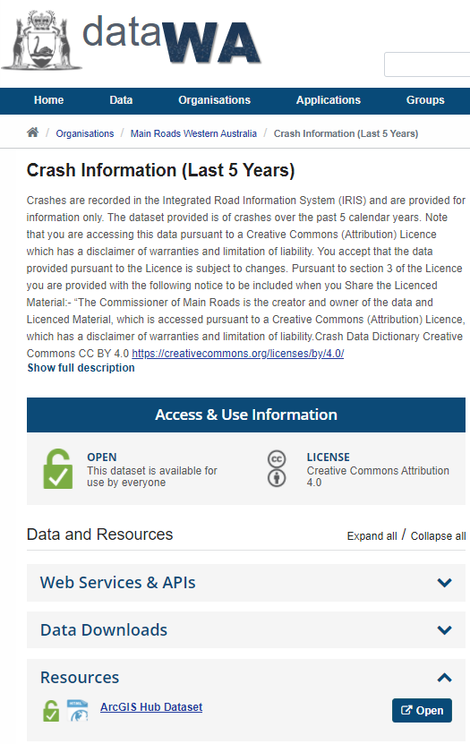
Data 4 – Car Crash in WA
Steps Taken:
Csv file was extracted from https://catalogue.data.wa.gov.au/dataset/mrwa-crash-information-last-5-years-
Data cleaning was undertaken directly in Python to delete irrelevant columns
Region category column (Northern, Metro, and Southern) was added using the same assumptions used in Data 1.
The data are then sliced and then summarised using Python to produce the following output:
No. Car accidents in 2016-2020 divided by types of accidents (i.e pedestrian, motorcycle, trucks, etc)
No. of car accidents involving pedestrian in 2016-2020, split based on region
No. of shark attacks vs no. of car accidents involving pedestrians
Notes:
Melissa to confirm

Slide 13
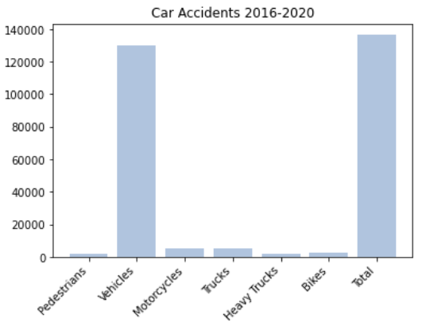
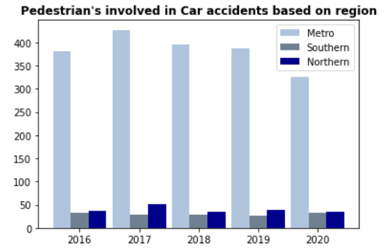
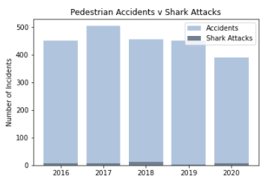
Data 4 Results – Car Crash in WA
Observation:
Between 2016-2020, largest contributor to car accidents in WA are car crash between vehicles. Crashes involving pedestrians only makes up a small proportion of total road accidents in WA.
Most car accidents involving pedestrians occur in Metro area. Accidents involving pedestrians is averaging around 452 accidents per year across WA
The number of shark attacks y-o-y is substantially lower compared to the number of pedestrians accidents y-o-y
Notes:
Katherine to Present
Katherine -> can you please edit the region graph bar with a title? Feel free to change the coloring as well.

Slide 14
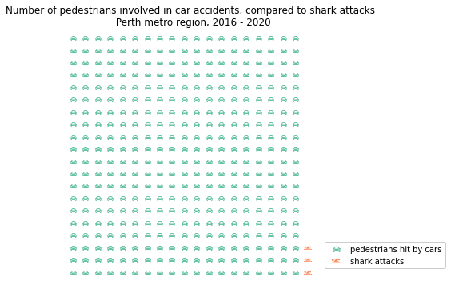
Are we more likely to be attacked by shark than hit by a car?
However….
We cross the road more often than we go to the beach

Slide 15
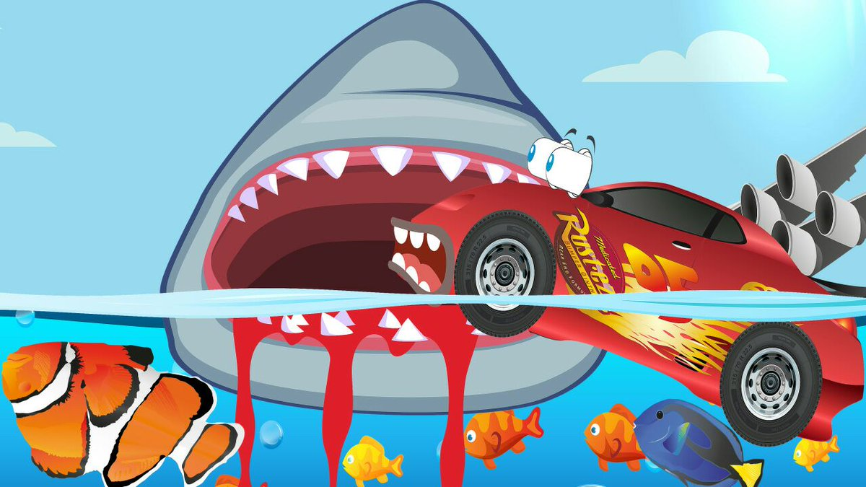
What are the odds?
Based on national coastal safety report 2018 we estimated the number of people engaging in ocean activity per year in WA to be 2.18m
Combined with our shark attack data, the odds of getting attacked by a shark is 1 in 270,000
In comparison, the chance of a pedestrian getting hit by a car (based on total WA population) is 1 in 2,000,000
Finally, the chance of being involved in a road accident is 1 in 65,000

Slide 16
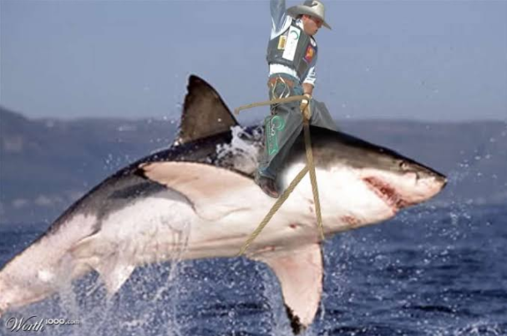
Are you feeling lucky?
Fun fact: attempting to lasso a shark can be hazardous to your health

